Slide 1
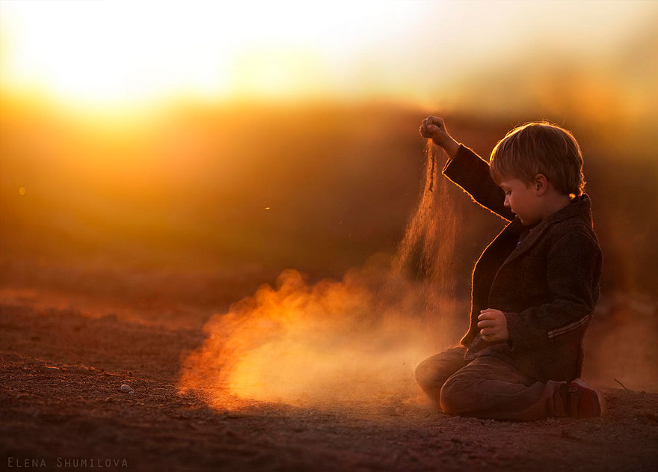
OBADIAH
BE HUMBLE
Dr. Rick Griffith • Singapore Bible College
BibleStudyDownloads.org

Slide 2
We all hate pride.
Yet we all struggle with it.
Notes:
We all hate pride. At least we hate it in others!
• Yet we all struggle with it. Do you agree?
Yet perhaps a more important question is this…

Slide 3
Why do you think we all struggle with
PRIDE
????
Notes:
Tell your answer to the person next to you in the next 60 seconds.

Slide 4
How does God respond to
PRIDE
????
Notes:
Does God hate pride too?

Slide 5

OT Bookshelf
Old Testament
Genesis - Malachi
Law (5)
History (12)
Poetry (5)
Prophecy (17)
Major 5 Minor 12
Notes:
We try to preach from various sections of Scripture here at this church. In recent years, we have series on Genesis (Law), Judges (History), Poetry (Ecclesiastes), and Isaiah, Jeremiah, and Daniel (Major Prophets). Sounds like time to get into the Minor Prophets, right?

Slide 6
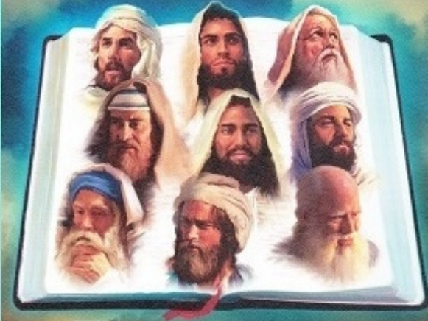
The Twelve
Courage to Confront Culture
—A Preaching Series on the Minor Prophets—
Notes:
These twelve preaches courageously confronted their culture, each one writing one book. Since they were so small, the Jews bound them together into a single scroll that they simply called "The Twelve."

Slide 7

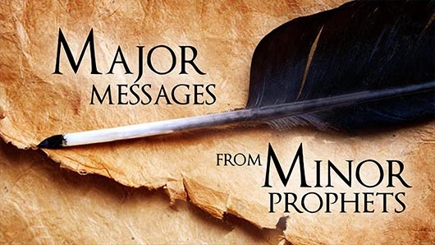
What do these men have to offer us?
Major
MESSAGES
FROM
Minor
PROPHETS
Notes:
One preacher called these "Major Messages from Minor Prophets." Yes, they are small books, but each has a punch you wouldn't believe until you go into them.
So that's what we will do the next 12 times I preach, interspersed with messages from Romans from Andrew and some miscellaneous ones from others.

Slide 8
How does God respond to
PRIDE
????

Slide 9
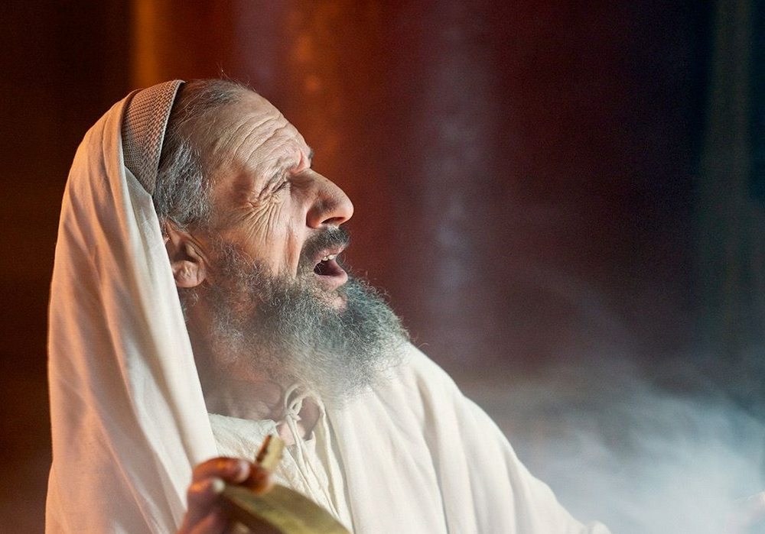
"The vision of Obadiah"
(Obadiah 1 NIV).
No king = No Time Period
Notes:
Unlike all of the prophets except Joel, Obadiah does not give the name of the king while he prophesied. This makes it tough to know when he wrote.

Slide 10
Different Dates Proposed
595
?
845 735 586 450 BC
Only indication of date (vv. 10-14)
The best date seems to be ca. 845 BC

Slide 11
How does God respond to
PRIDE
????

Slide 12
Obadiah Summary Chart
594
Edom's Destruction for Opposing Judah
Edom's Destruction |  |  | Day of the LORD
Verses 1-14 |  |  | Verses 15-21
Judgment on Edom |  |  | Blessing on Judah
Proud Esau Defeats Defenseless Jacob |  |  | Powerful Jacob Defeats Humbled Esau
Edom's Contempt & Crimes |  |  | Edom's Condemnation & Calamities
Past |  |  | Future
Author | Judgment | Reasons | Destruction | Possession
Inspired Title 1a | Humbling Prophesied 1b-9 | Judgment for Injustices 10-14 | Judgment on Modern Enemies 15-16 | Blessing on Modern Israel 17-21

Slide 13
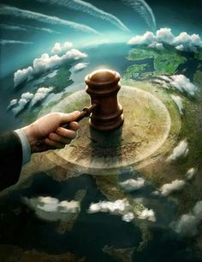
I. God judges the proud.
Obadiah 1-14
Notes:
The LORD pushes down those who exalt themselves.

Slide 14
"The vision of Obadiah"
(Obadiah 1 NIV).
No king = No Time Period
Notes:
Unlike all of the prophets except Joel, Obadiah does not give the name of the king while he prophesied. This makes it tough to know when he wrote.

Slide 15
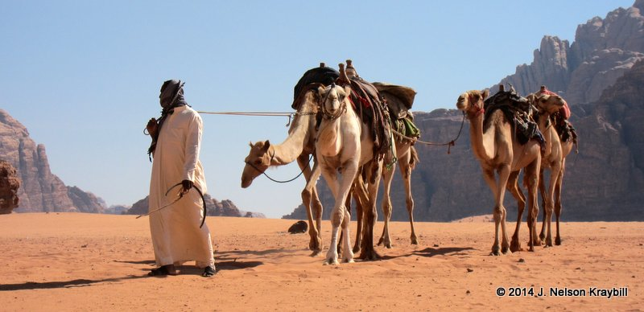
"This is what the Sovereign LORD says about Edom—
We have heard a message from the LORD:
An envoy was sent to the nations to say,
'Rise, and let us go against her for battle'—"
(Obadiah 1b NIV).
Notes:
God invites the nations to come and judge Edom (1b) [which occurred as the Nabateans, Jews under John Hyrcanus, and Romans under Titus all contributed to the annihilation of the Edomites].

Slide 16
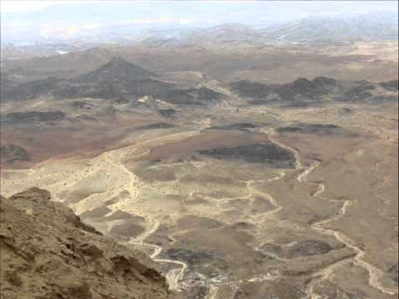
"See, I will make you small among the nations; you will be utterly despised"
(Obadiah 2 NIV).

Slide 17
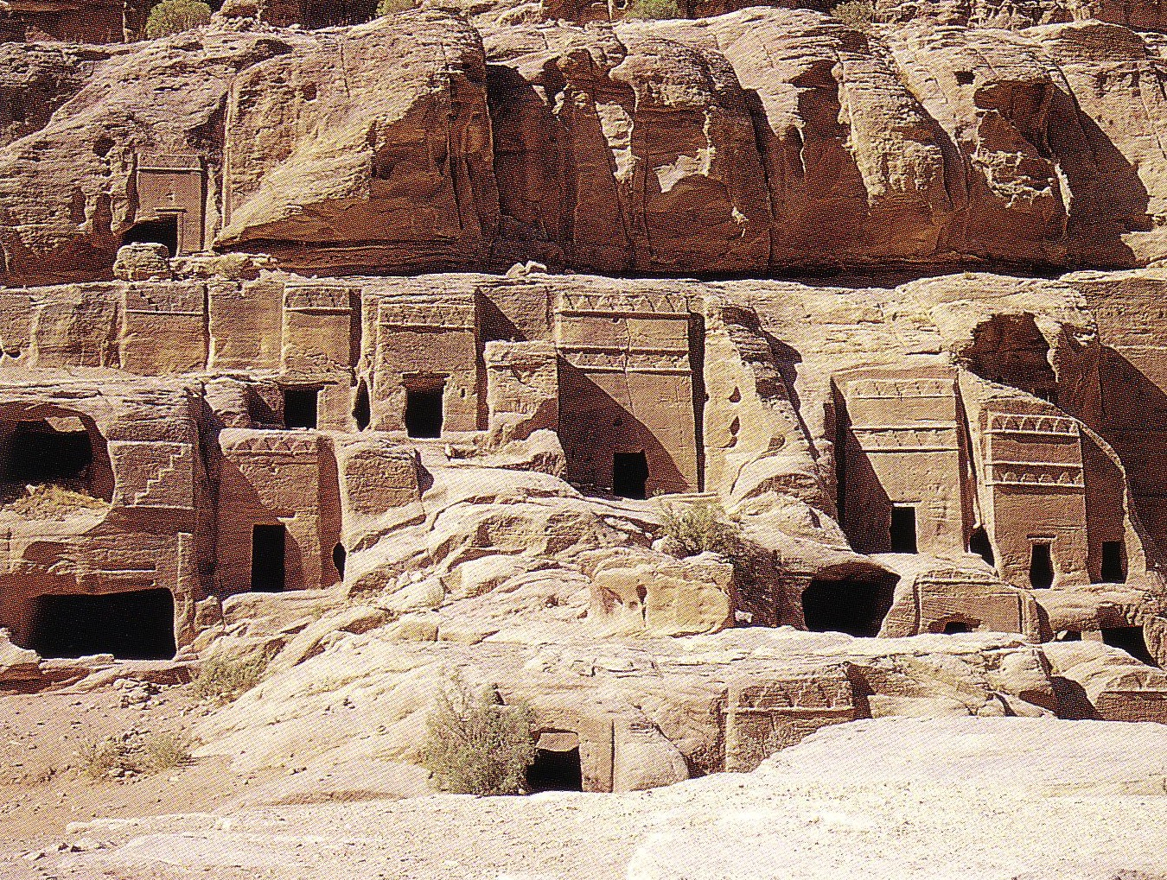
"The pride of your heart has deceived you, you who live in the clefts of the rock, in your lofty dwelling, who say in your heart, 'Who will bring me down to the ground?'" (Obadiah 3)
598c
Notes:
The LORD describes Edom's destruction aided by deceptive allies and involving a humiliating slaughter and plundering (1b-9). Note the Fulfillment: The Nabateans around 500 BC were invited to an Edomite banquet but deceived, slaughtered and plundered the Edomites.
God describes Edomite destruction by the nations as being brought low in humiliation from arrogant dwellings high in the rocks and as a fallen eagle (1b-4).

Slide 18


Geographical Setting
444
598d
Jacob
Israel
Esau
Edom

Slide 19
Purpose
597
The book of Obadiah has a twofold purpose:
to delineate God's judgment on Edom for its lack of brotherly concern for Judah
to set forth the final triumph of right in the Day of the LORD

Slide 20
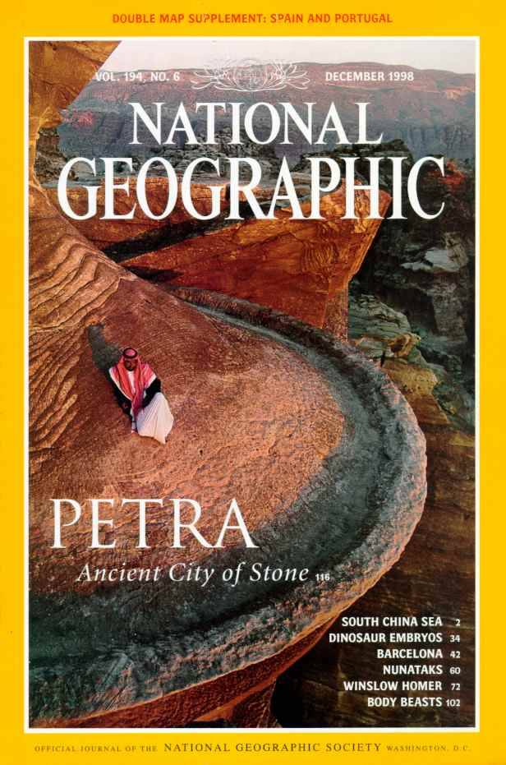
National Geographic has several articles on Petra back to 1907
Here's Dec. 1998

Slide 21
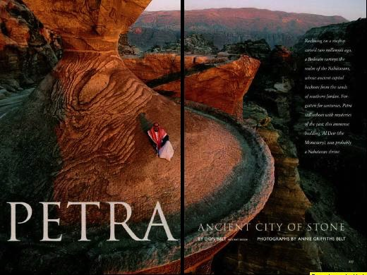
Petra Article Front Page

Slide 22
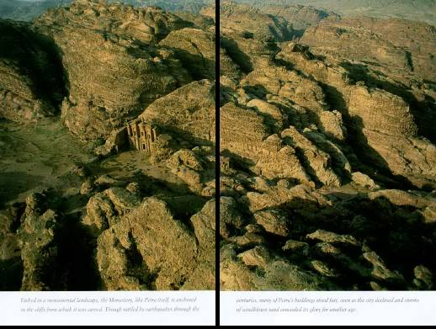
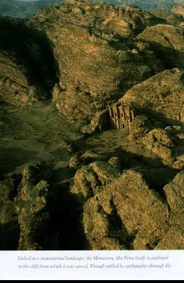
Imagine living in this terrain!

Slide 23
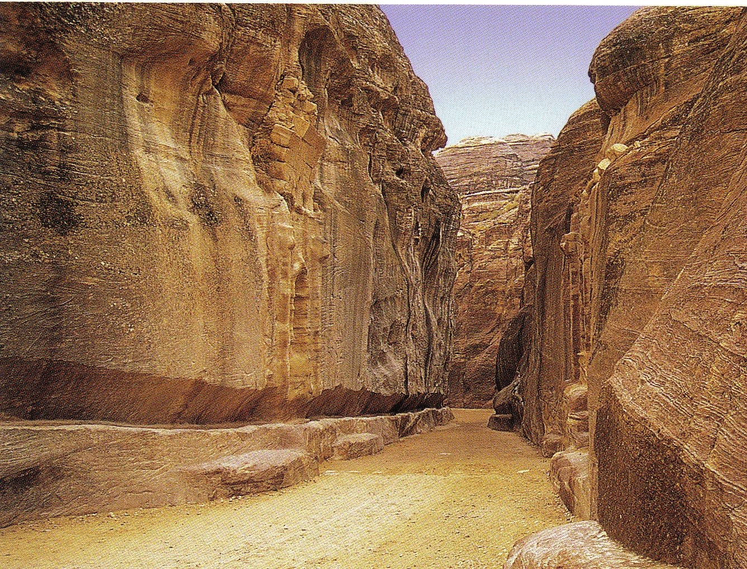
The Siq
(pronounced "seek")
598c
The only entrance to Petra
Water Course

Slide 24
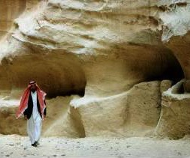
Water channels were buried for centuries

Slide 25
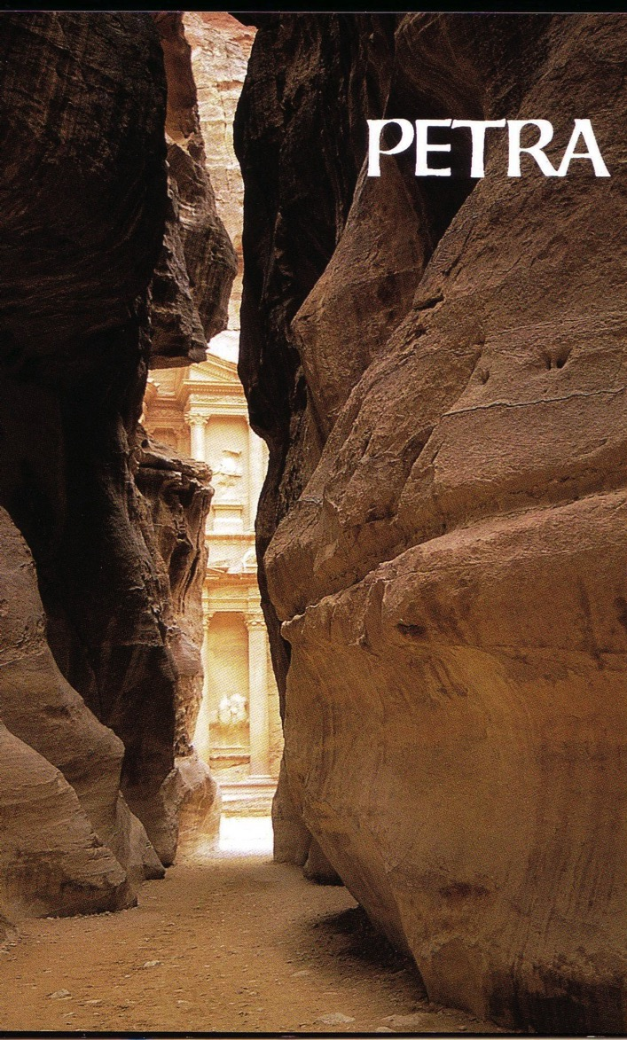
Exit of the Siq
598b

Slide 26
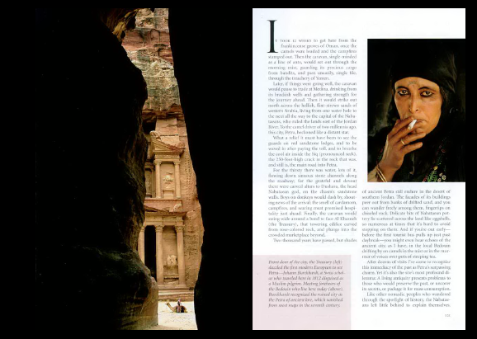
Dark Siq Exit

Slide 27
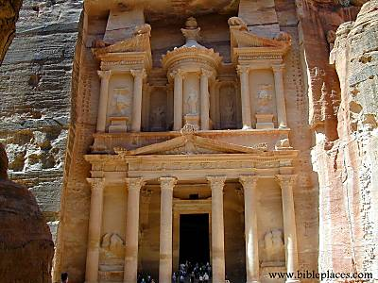
The Treasury
598b

Slide 28
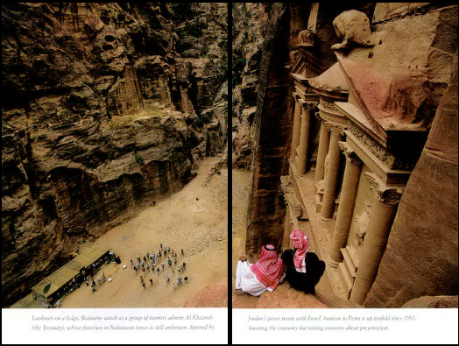
From atop the Treasury

Slide 29
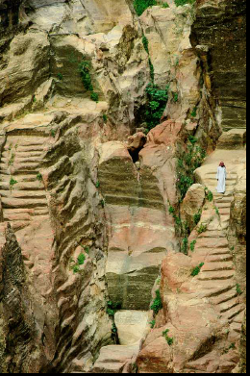
Nabataean engineers ingeniously collected the mere 6 inches of annual rainfall.

Slide 30
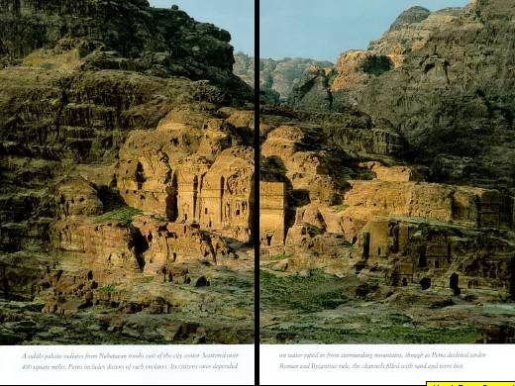
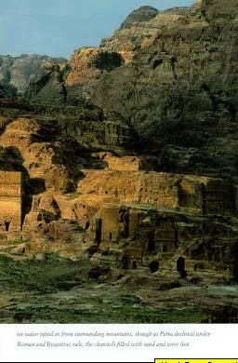
Nabatean tombs east of the city center

Slide 31
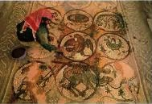
Byzantine Church Mosaic (5th century)

Slide 32
"The pride of your heart has deceived you, you who live in the clefts of the rock, in your lofty dwelling, who say in your heart, 'Who will bring me down to the ground?'" (Obadiah 3)
598c

Slide 33
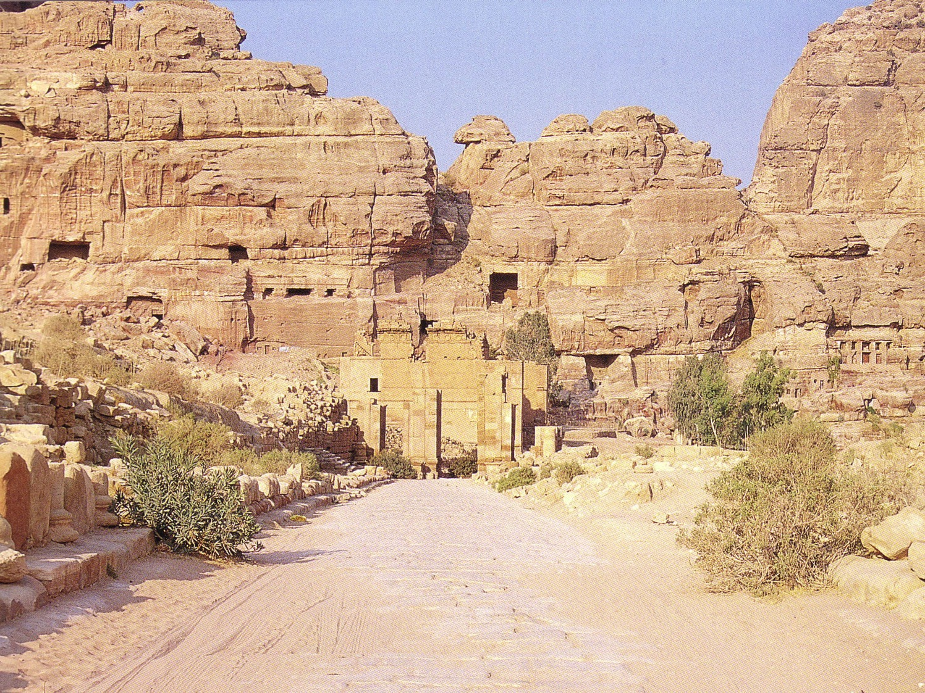
Colonnade Envisioned
598c

Slide 34
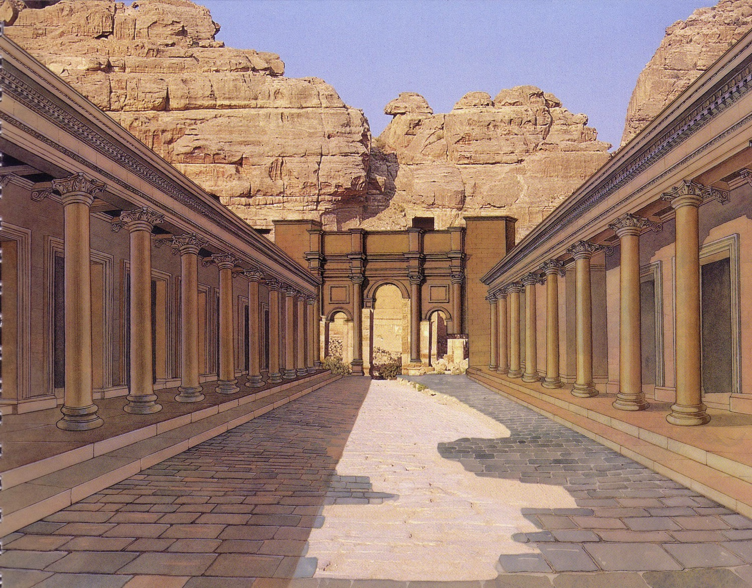
Colonnade Realized
598c

Slide 35
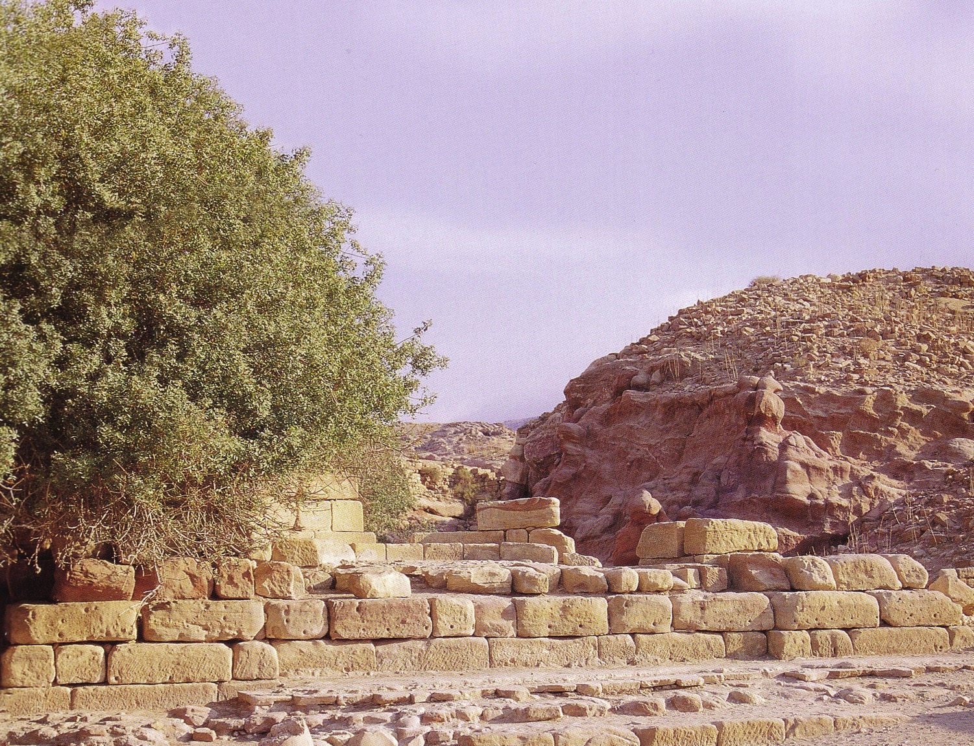
Nymphaleon

Slide 36
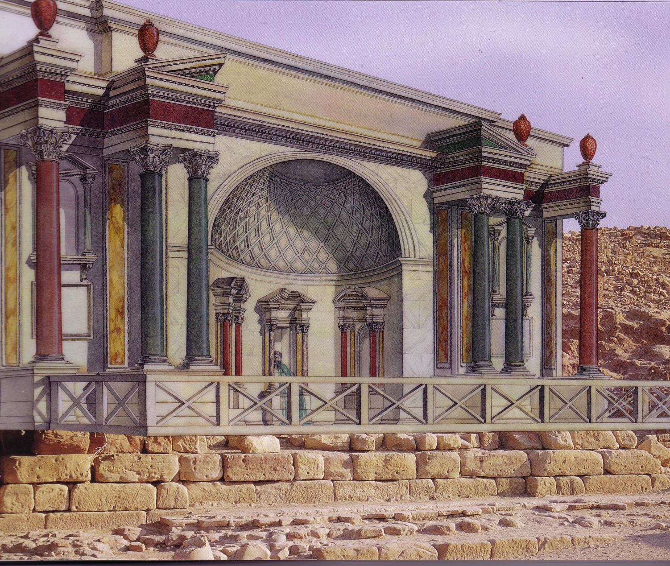
Nymphaleon

Slide 37
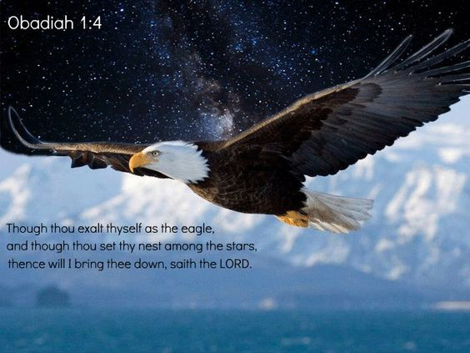
”'Though you soar like the eagle and make your nest among the stars, from there I will bring you down,' declares the LORD."
Obadiah 4 (NIV)

Slide 38
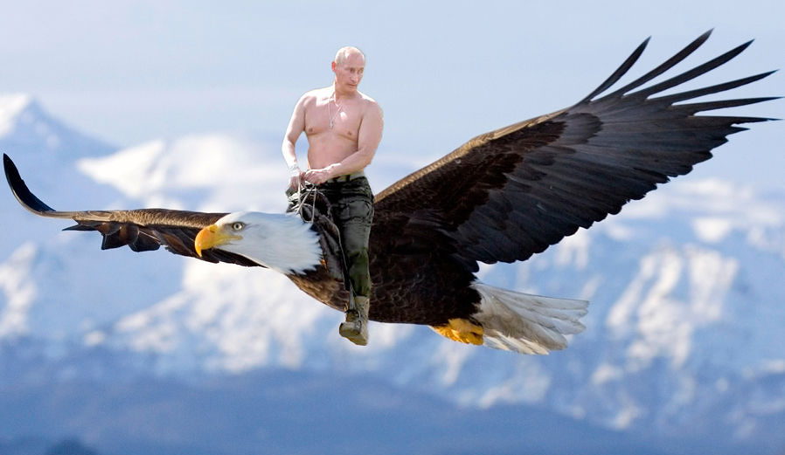
"'Though you soar like the eagle and make your nest among the stars, from there I will bring you down,' declares the LORD" (Obadiah 4 NIV).

Slide 39
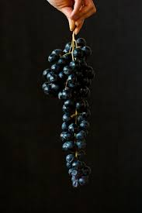
"If thieves came at night and robbed you (what a disaster awaits you!), they would not take everything. Those who harvest grapes always leave a few for the poor. But your enemies will wipe you out completely!”
(Obadiah 5 NLT).

Slide 40

"Every nook and cranny of Edom will be searched and looted. Every treasure will be found and taken”
(Obadiah 6 NLT).

Slide 41
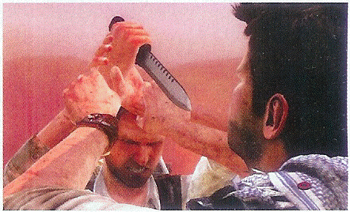
"All your allies will turn against you. They will help to chase you from your land. They will promise you peace while plotting to deceive and destroy you. Your trusted friends will set traps for you, and you won't even know about it"
(Obadiah 7 NLT).

Slide 42
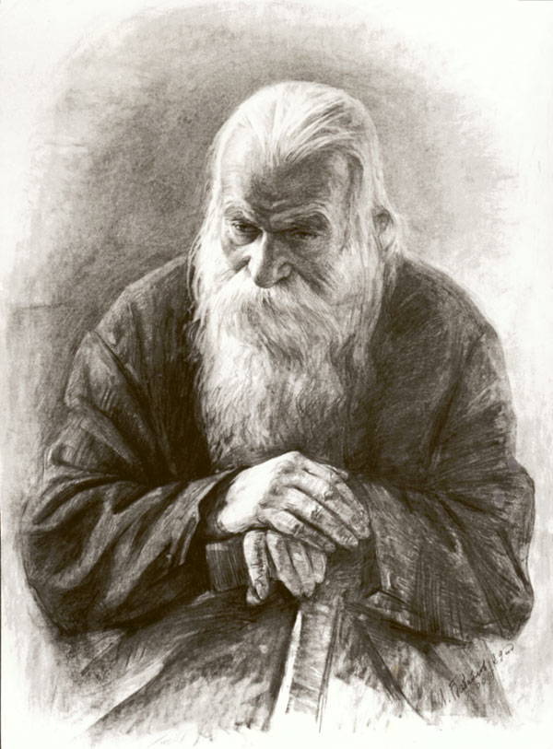
"'At that time not a single wise person will be left in the whole land of Edom,' says the LORD. 'For on the mountains of Edom I will destroy everyone who has understanding'"
(Obadiah 8 NLT).

Slide 43
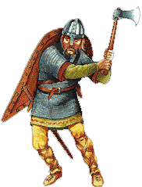
"The mightiest warriors of Teman will be terrified, and everyone on the mountains of Edom will be cut down in the slaughter"
(Obadiah 9 NLT).

Slide 44
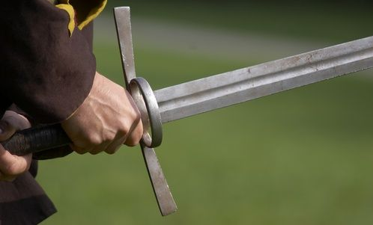
"Because of the violence against your brother Jacob, you will be covered with shame; you will be destroyed forever”
(Obadiah 10 NIV).

Slide 45
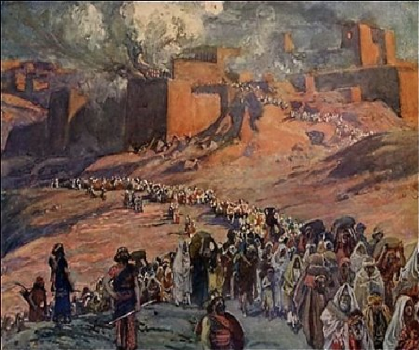
"On the day you stood aloof while strangers carried off his wealth and foreigners entered his gates and cast lots for Jerusalem, you were like one of them” (Obadiah 11 NIV).

Slide 46
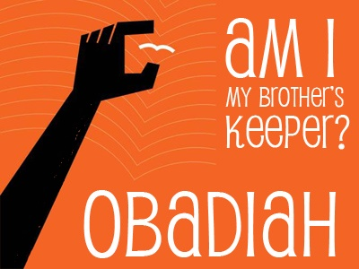
Edom's Excuse
Am I my brother's keeper?
OBADIAH

Slide 47
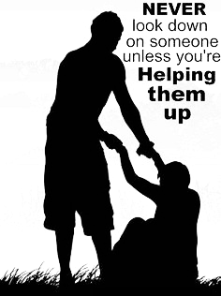
"You should not look down on your brother in the day of his misfortune, nor rejoice over the people of Judah in the day of their destruction, nor boast so much in the day of their trouble”
(Obadiah 12 NIV).
NEVER
look down on others unless you're
HELPING THEM UP

Slide 48
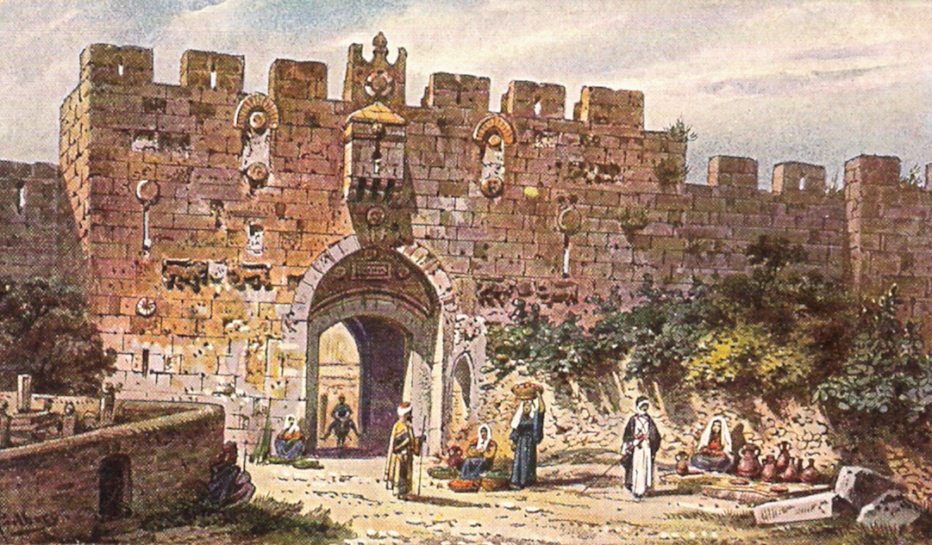
"You should not march through the gates of my people in the day of their disaster, nor look down on them in their calamity in the day of their disaster, nor seize their wealth in the day of their disaster" (Obadiah 13 NIV).

Slide 49
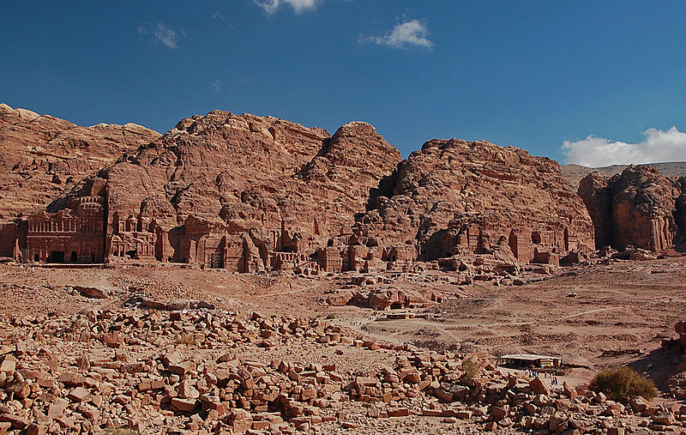
"You should not wait at the crossroads to cut down their fugitives, nor hand over their survivors in the day of their trouble" (Obadiah 14 NIV).

Slide 50


"God resists
the proud…
…but gives grace to the humble."
1 Peter 5:5b (NIV)

Slide 51

The Rainbow
A PROMISE OF GOD,
NOT A SYMBOL OF PRIDE

Slide 52

"The LORD detests all the proud of heart. Be sure of this: They will not go unpunished."
Proverbs 16:5 (NIV)

Slide 53
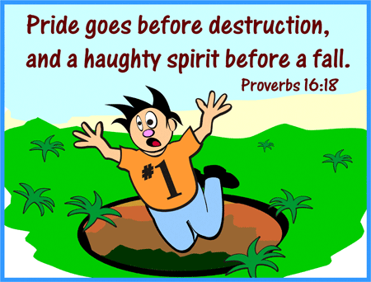
"Pride goes before destruction and a haughty spirit before a fall."
Pride goes before destruction,
a haughty spirit before a fall.
Proverbs 16:18
Proverbs 16:18 (NIV)

Slide 54
Broken People
145-146
Henry Blackaby
PROUD, UNBROKEN PEOPLE
BROKEN PEOPLE
Keep people at arms length
Risk getting close to others/willing to take the risks of loving intimately
Quick to blame others
Accept personal responsibility – can see where they were wrong
Unapproachable
"Easy to be entreated"
Defensive when criticized
Receive criticism with a humble, open heart
Concerned with being "respectable"
Concerned with being real
Concerned about what others think
All that matters is what God knows
Work to maintain image/protect reputation
Die to own reputation
Find it difficult to share
their spiritual needs with others
Willing to be open / transparent with others
Want to be sure nobody finds out
about their sin.
Willing to be exposed (Once broken, you don't care who knows – nothing to lose!)
Notes:
BE-31-Obadiah-54
OS-04-Numbers-272
OS-31-Obadiah-129

Slide 55
Broken People
145-146
Henry Blackaby
PROUD, UNBROKEN PEOPLE
BROKEN PEOPLE
Have a hard time saying, "I was wrong; will you please forgive me?"
Are quick to admit failure and to seek forgiveness
When confessing sin, deal in generalities
Deal in specifics
Concerned about the consequences
of their sins
Grieved over the cause / root of their sins
Remorseful over their sin—
got caught / found out
Repentant over sin (forsake it)
When there is a misunderstanding or conflict, wait for the other to come & ask forgiveness
Take the initiative to be reconciled;
see if they can get to the cross first!
Compare themselves with others
and feel deserving of honor
Compare themselves to the holiness of God and feel desperate need for mercy
Blind to their true heart condition
Walk in the light
Don't think they have anything to repent of
Continual heart attitude of repentance
Don't think they need revival
(think everybody else does!)
Continually sense their need for a fresh
encounter with the filling of His Spirit
Notes:
BE-31-Obadiah-55
OS-04-Numbers-273
OS-31-Obadiah-130

Slide 56
I. God judges the proud.
Obadiah 1-14
Notes:
The LORD pushes down those who exalt themselves.

Slide 57
How does God respond to
HUMILITY
????

Slide 58
Key Verses
594
Judgment on Edom
  (God to Edom) "Because of the violence against your brother Jacob [Judah], you will be covered with shame; you will be destroyed forever" (v. 10)
Blessing on Israel
  "Deliverers will go up on Mount Zion [Jerusalem] to govern the mountains of Esau. And the kingdom will be the LORD's" (v. 21)

Slide 59
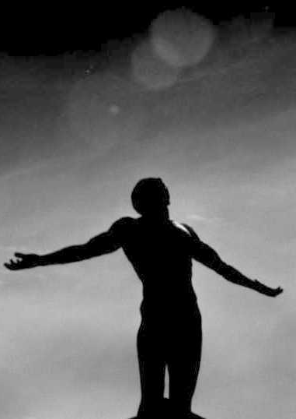
II. God blesses the humble.
Obadiah 15-21

Slide 60
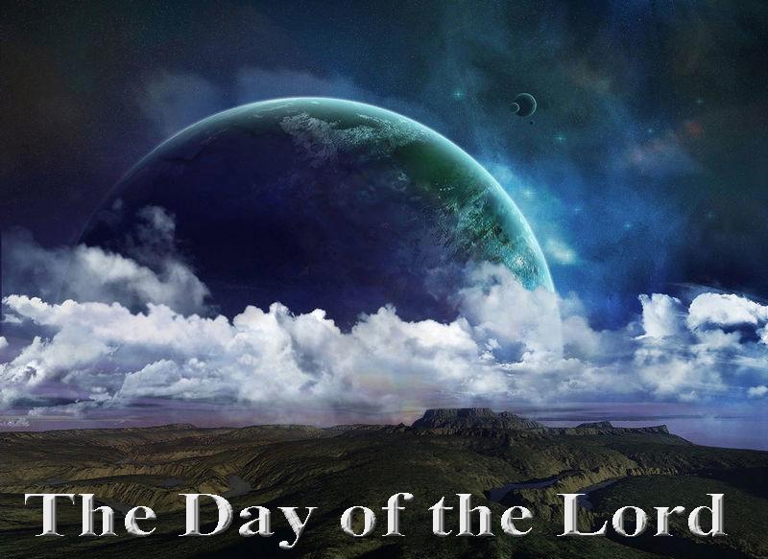
"The day of the LORD is near for all nations.
As you have done, it will be done to you; your deeds will return upon your own head" (Obadiah 15 NIV).

Slide 61
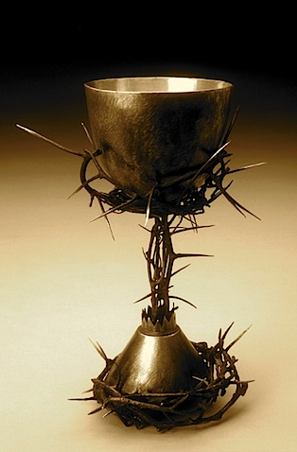
"Just as you swallowed up my people on my holy mountain, so you and the surrounding nations will swallow the punishment I pour out on you. Yes, all you nations will drink and stagger and disappear from history"
(Obadiah 16 NLT).

Slide 62

Reversal in Obadiah
140
Edom Over Israel
Israel Over Edom
Judah
1-14
15-21
Edom

Slide 63
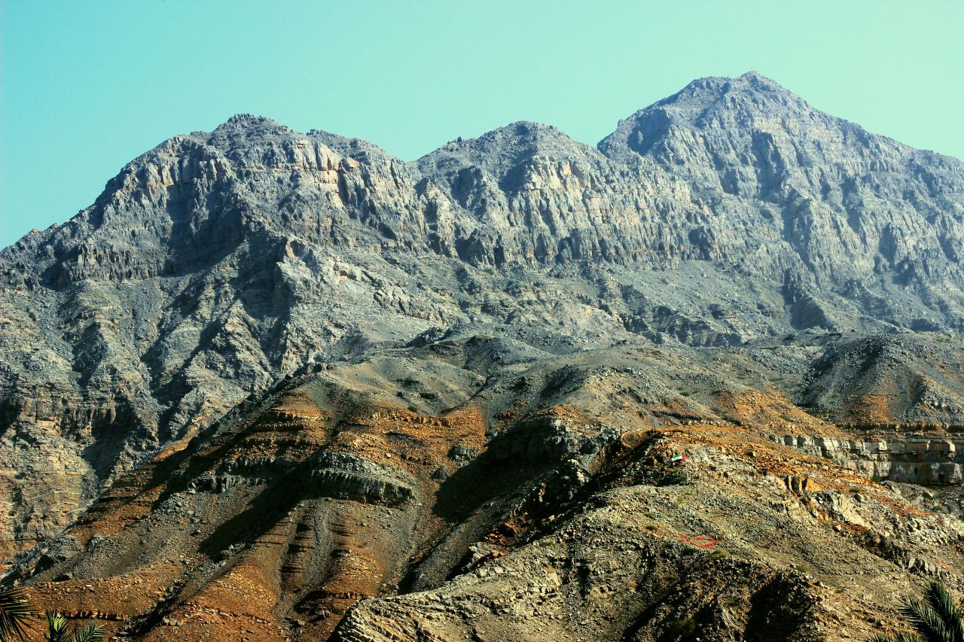
Approaching a Summit
Notes:
When we approach the summit of a mountain range, it looks like the peaks continually go upward.

Slide 64

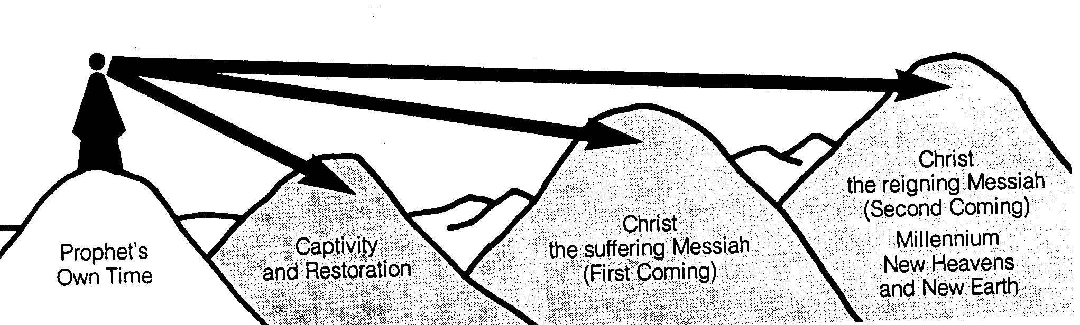
Time Periods of the Prophets
442
New Heavens & New Earth
Christ's Second Coming to Reign in Millennium
Christ's First Coming to Suffer
Exile & Return
Prophet's Own Time
Adapted significantly from Salem Kirban, Charts on Revelation (1979), 49
Notes:
The prophets often looked to the future, but did not know how far their prophecies referred. It is like a person standing on mountain looking into the distance and seeing what appears to be the same mountain. However, the person standing at these same mountains from the side can clearly see significant gaps between the peaks. Such is the viewpoint that we have thousands of years later. Generally there existed five time periods, including the prophet’s own era.
____________
Common Slides English-151
BE-31-Obadiah-64
OS-OT_Book_Overviews-782_pp42a_and_347a-613
OS-23-Prophets_Introduction-19
OS-31-Obadiah-13

Slide 65
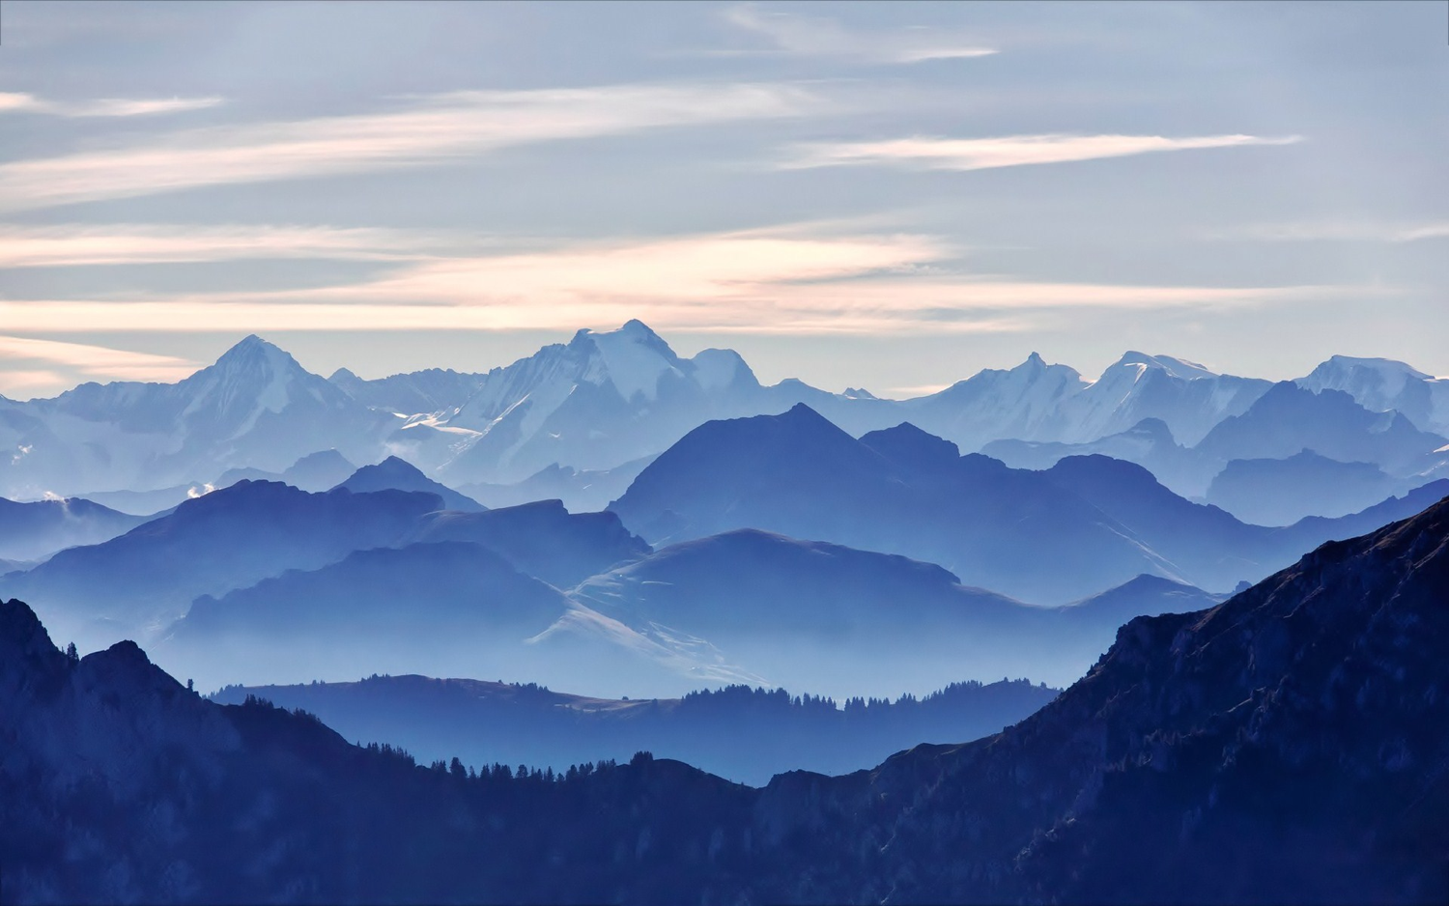
We See the Valleys
Notes:
From our vantage point, we clearly see that the Messiah would come twice. It's like being able to see the valleys between each set of peaks. However, the prophets did not see these valleys but only saw the future as a whole.

Slide 66
A Dispensational Timeline
437
Great
White
Throne
(Rev. 20:11-14)
Rapture
(1 Thess. 4:13-18)
2nd Advent
(Zech. 14:3-5)
Day of the LORD
Church Age
Tribulation
(Zech. 14:1-2)
Millennium
(Zech. 14:6-21)
Gog & Magog
(Armageddon)
(Ezek. 38–39)
Gog and Magog
Revisited
(Rev. 20:7-10)
Notes:
66

Slide 67
Reversal in Obadiah
140
"But Jerusalem will become a refuge for those who escape;
it will be a holy place.
And the people of Israel will come back to reclaim their inheritance"
(Obadiah 17 NLT).
Judah
Edom

Slide 68
Reversal in Obadiah
140
"The people of Israel will be a raging fire, and Edom a field of dry stubble. The descendants of Joseph will be a flame roaring across the field, devouring everything. There will be no survivors in Edom. I, the LORD, have spoken"
(Obadiah 18 NLT).
Judah
Edom

Slide 69

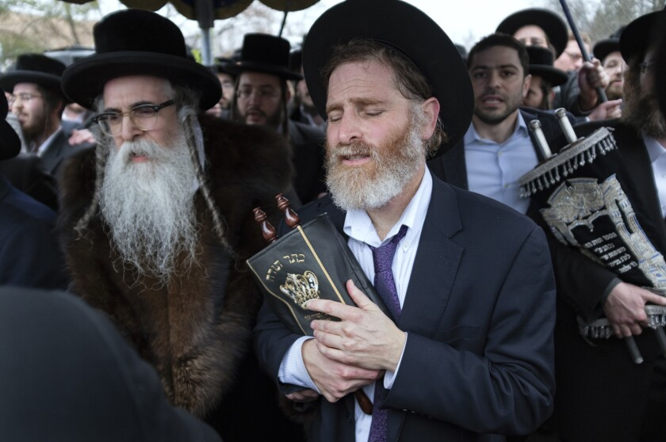
Is There a Future for National Israel?
155u

Slide 70

7
Gen. 17
ABRAHAM
ABRAHAM
ca. 2000 B.C.
The CALL
AC
L - S - B
AJMJ
I - I
Gen. 12:1-3
ABRAHAM
The CALL
L - S - B
I - I
ISHMAEL & ISAAC
Handbook pg. 19-24
28
Notes:
So…the letters I and I appear on ABRAHAM's file folder. From these two sons of Abraham….ISHMAEL and ISAAC...
right here at this crucial historic point…the terrible Jewish-Arab conflict of our own time begins some 4,000 years ago...around 2000 B.C.

Slide 71
7
ABRAHAM
ABRAHAM
ca. 2000 B.C.
The CALL
AC
L - S - B
AJMJ
Gen. 12:1-3
I - I
ABRAHAM
The CALL
L - S - B
I - I
ARABIC PEOPLES
THROUGH ISHMAEL
JEWISH PEOPLE
THROUGH ISAAC
Handbook pg. 19-24
29
2
Notes:
Because...
//// …ISHMAEL is recognized today as the father of the Arab nations…through ABRAHAM…
//// while ISAAC, of course, is revered as one of the founding patriarchs of the Jews…also through ABRAHAM!

Slide 72
7
ABRAHAM
ABRAHAM
ca. 2000 B.C.
The CALL
AC
L - S - B
AJMJ
Gen. 12:1-3
I - I
ABRAHAM
The CALL
L - S - B
I - I
ARABIC PEOPLES
THROUGH ISHMAEL
JEWISH PEOPLE
THROUGH ISAAC
Handbook pg. 19-24
30
Notes:
There is enormous conflict between the two half-brothers and their mothers. And as we watch or read today's news, we see that that age-old turmoil begun in ABRAHAM's tent 4,000 years ago continues today! Both the Jews and the Arabs claim ABRAHAM as the beginning point of their respective peoples!

Slide 73
7
Gen. 22:2; 2 Chr. 3:1
WHICH SON?
"Then God said, "Take your son, your only son, Isaac, whom you love, and go to the region of Moriah. Sacrifice him there as a burnt offering, on one of the mountains I will tell you about." Genesis 22:2
ABRAHAM
The CALL
L - S - B
I - I
NIV study note: :"In the Hebrew text, "Isaac" follows the clause "whom you love," in order to heighten the effect: "your son, your only son, whom you love -- Isaac." Isaac was the only "son of the Promise."
2 Chr 3:1 The author identifies this site with the Temple mount [locating today's Dome of the Rock].
Handbook pg. 19-24
31
3
Notes:
The question then arises: how do we know WHICH SON was REALLY the inheritor of the Abrahamic promises? Look at Genesis 22:2…
//// "The God said, "Take your son, your only son, Isaac, whom you love, and go to the region of Moriah. Sacrifice him there as a burnt offering, on one of the mountains I will tell you about."
//// Look at this study note from the NIV translation: "In the Hebrew text, "Isaac" follows the clause "whom you love," in order to heighten the effect: "your son, your only son, whom you love – Isaac." Isaac was the only "son of the Promise."
//// Here also, you'll find in Second Chronicles 3:1 that God identifies Moriah with the Temple mount, which, today, is the site of the Moslem Dome of the Rock." Much more on that location a little later.

Slide 74
7
Gen. 17:20-21
WHICH SON?
"And as for Ishmael, I have heard you. Behold I have blessed him, and will make him fruitful, and will multiply him exceedingly. He shall beget twelve princes, and I will make him a great nation. But My covenant I will establish with Isaac, whom Sarah shall bear to you at this set time next year."
Gen. 17:20-21 (NKJV)
ABRAHAM
The CALL
L - S - B
But My covenant I will establish
I - I
with Isaac
Handbook pg. 19-24
32
2
Notes:
But Ishmael was not forgotten…not at all!
//// Genesis 17: 20-21…"And as for Ishmael, I have heard you. Behold I have blessed him, and will make him fruitful, and will multiply him exceedingly. He shall beget twelve princes, and I will make him a great nation.
//// But My covenant I will establish with Isaac, whom Sarah shall bear to you at this set time next year."

Slide 75
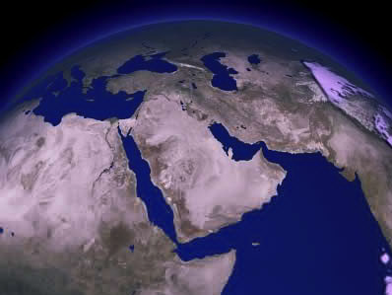
COMPARE THE GIFTS TODAY…
ISAAC
ABRAHAM
ISHMAEL
The CALL
L - S - B
I - I
WHY THE ENORMOUS DIFFERENCE?
Handbook pg. 19-24
33
3
Notes:
It's interesting to compare those gifts today…
//// Generally speaking…here are the lands populated today by the descendants of Ishmael…the lands of the Middle East.
//// But then…compare that with the descendants of Isaac in the Middle East…right there in tiny Israel.
//// Why the enormous difference?

Slide 76
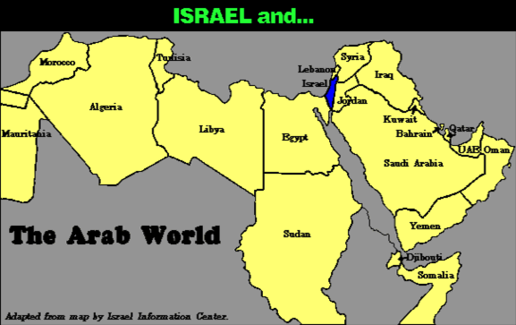
7
COMPARE THE GEOGRAPHY…
Israel and…
ABRAHAM
The CALL
L - S - B
The Arab World
I - I
Handbook pg. 19-24
34
Notes:
Practically speaking…just compare the geography…today's Israel versus the rest of the Arab world!

Slide 77
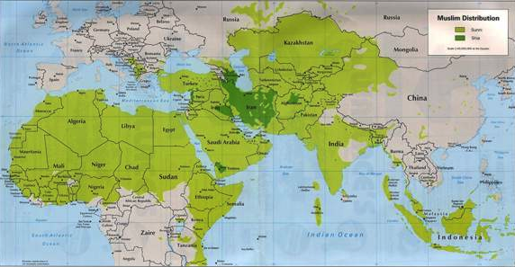
7
COMPARE THE GEOGRAPHY…
ABRAHAM
The CALL
L - S - B
I - I
MOHAMMED VERSUS ISAAC!
Handbook pg. 19-24
35
Notes:
But there is something else at work here. Compare the Middle Eastern influence of Ishmael's descendant, Mohammed, founder of Islam…with that of Isaac, the great Israelite patriarch, and the brother of Ishmael!

Slide 78
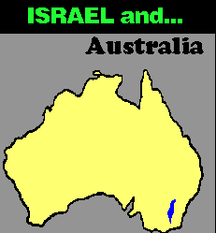





7
COMPARE THE GEOGRAPHY…
ISRAEL and…
ISRAEL and…
Australia
ISRAEL and…
France
California
ISRAEL and…
ISRAEL and…
Singapore
ABRAHAM
The CALL
L - S - B
I - I
Maine
Maps drawn to same scale with Israel in blue
Handbook, pages 19-24
4
36
9.65.03b.
Notes:
In today's geopolitical world…compare the size of tiny Israel with
Australia…
//// Israel with France…
//// Israel and the United States' state of Maine…or
//// Israel and California.
//// The width of Singapore and Israel are about the same.

Slide 79

7
ISRAEL and…
THE UNITED STATES
ABRAHAM
The CALL
L - S - B
I - I
DOES THIS SEEM FAIR?
Handbook pg. 19-24
37
Notes:
And finally…even when Israel is compared to the entire United States…from the north to the south…from east to west: when it comes to size alone, there is enormous disparity between Isaac and Ishmael! Why is this so? How can we explain it?

Slide 80
7
"…the Ishmaelites were given more land and ultimately more wealth than Israelites. This was true in their past history, not to mention the vast oil wealth of modern times. And spiritual salvation has always been open to the Ishmaelites.
ABRAHAM
The CALL
L - S - B
I - I
Hal Lindsey, The Everlasting Hatred: The Roots of Jihad (2002), 65
Handbook pg. 19-24
38
Notes:
Look at this passage from Hal Lindsay's 2002 book, The Everlasting Hatred: The Roots of Jihad:
"…the Ishmaelites were given more land and ultimately more wealth than Israelites. This was true in their past history, not to mention the vast oil wealth of modern times. And spiritual salvation has always been open to the Ishmaelites."
[Continue to the next part of the passage below.]

Slide 81
7
"…the Ishmaelites were given more land and ultimately more wealth than Israelites. This was true in their past history, not to mention the vast oil wealth of modern times. And spiritual salvation has always been open to the Ishmaelites.
But God's covenant, which concerned His spiritual purposes, was only for Isaac and his descendants. The physical blessings promised to Isaac were to facilitate God's spiritual call for the nation that would come from him." [Emphasis added]
ABRAHAM
The CALL
L - S - B
I - I
Hal Lindsey, The Everlasting Hatred: The Roots of Jihad, 2002, p. 65
Handbook pg. 19-24
39
Notes:
"But God's covenant, which concerned His spiritual purposes, was only for Isaac and his descendants. The physical blessings promised to Isaac were to facilitate God's spiritual call for the nation that would come from him."

Slide 82
7
LEBANON
Mediterranean Sea
DESCENDANTS OF ISAAC
SYRIA
Sea of Galilee
IRAQ
Haifa
Nazareth
Netanya
JORDAN
Tel Aviv-Jaffa
AMMAN
JERUSALEM
Jericho
Gaza
Hebron
Dead Sea
ABRAHAM
Beersheba
The CALL
ISRAEL
L - S - B
I - I
DESCENDANTS OF ISHMAEL
EGYPT
SAUDI ARABIA
Eilat
Al' Aqaba
Gulf of Aqaba
ISHMAEL & ISAAC IN TODAY'S ISRAEL
Handbook pg. 19-24
40
2
Notes:
And inside the ancient Land right now…
//// Here, the descendants of Isaac
//// and the descendants of Ishmael continue today -- that endless conflict begun in Abraham's tent in ancient Palestine or Canaan – or Israel -- so long ago. Jewish Israel is engulfed by the descendants of Ishmael in surrounding countries on all sides! The implications of that circumstance in our own day are enormous.

Slide 83

Borders of the Land Promised to Abraham
531e
Syria
Lebanon
Israel
Jordan
Genesis 15:18
"On that day the LORD made a covenant with Abram, saying, 'To your offspring I give this land, from the river of Egypt to the great river, the river Euphrates'" (ESV)
India
Egypt
Notes:
God's promised land stretched northeard from the small wadi of Egypt south in the Sinai to the large Euphrates River in the far north—a HUGE piece of real estate! When today's boundaries are placed over this land we can see the struggle modern Israel has to claim land from Egypt, Lebanon, Syria and possibly even Jordan on the other side of the Jordan River.

Slide 84
God's Promise
(vv. 19-20)
Zarephath
"People from the Negev will occupy the mountains of Esau, and people from the foothills will possess the land of the Philistines. They will occupy the fields of Ephraim and Samaria, and Benjamin will possess Gilead.
²⁰This company of Israelite exiles who are in Canaan will possess [the land] as far as Zarephath; the exiles from Jerusalem who are in Sepharad will possess the towns of the Negev."
444
598d
Gilead
Samaria
Ephraim
Benjamin
Philistines
Foothills
Negev
Esau

Slide 85
Bible Lands Blank Map
Where was Sepharad (v. 20)?
Spain?
Sardis, Asia Minor?
Media?
Hesperides, Libya?
"…the exiles from Jerusalem who are in Sepharad will possess the towns of the Negev."
© EBibleTeacher.com
Notes:
"Others exiled from Jerusalem to Sepharad, will possess ... the Negev. Suggestions on the location of Sepharad include two countries (Spain, Media) and two cities (Hesperides in Libya, and Sardis in Asia Minor). Sardis seems preferable. It may be the same as the Akkadian Sapardu. If Sepharad is to be identified with Sardis, then Jews there will be returning a distance of almost 400 miles to the Negev. At the beginning of the Millennium Israelites will return to their land from these and other lands, and their territory will be expanded" (Walter L. Baker, "Obadiah," in The Bible Knowledge Commentary, on Obadiah v. 20).

Slide 86
God's Promise
(v. 20)
"People from the Negev will occupy the mountains of Esau, and people from the foothills will possess the land of the Philistines. They will occupy the fields of Ephraim and Samaria, and Benjamin will possess Gilead.
²⁰This company of Israelite exiles who are in Canaan will possess [the land] as far as Zarephath; the exiles from Jerusalem who are in Sepharad will possess the towns of the Negev."
444
598d
Negev

Slide 87
God's Promise
(v. 21)
"Deliverers will go up on Mount Zion to govern the mountains of Esau. And the kingdom will be the LORD's."
444
598d
Zion
Esau

Slide 88

…so that at the proper time he may exalt you."
"Humble yourselves, therefore, under the mighty hand of God…
1 Peter 5:6

Slide 89
Broken People
145-146
Henry Blackaby
PROUD, UNBROKEN PEOPLE
BROKEN PEOPLE
Focus on the failures of others
Overwhelmed with sense of their own
spiritual need
Self-righteous; have a critical, fault-finding
spirit; look at own life/faults through a
telescope but others with a microscope
Compassionate; forgiving; look for the
best in others
Look down on others
Esteem all others better than self
Independent/self-sufficient spirit
Dependent spirit/recognize need for
others
Maintain control; must be my way
Surrender control
Have to prove that they are right
Willing to yield the right to be right!
Claim rights
Yield rights
Demanding spirit
Giving spirit
Self-protective of time, rights, reputation
Self-denying
Notes:
BE-31-Obadiah-89
OS-04-Numbers-274
OS-31-Obadiah-176

Slide 90
Broken People
145-146
Henry Blackaby
PROUD, UNBROKEN PEOPLE
BROKEN PEOPLE
Desire to be served
Motivated to serve others
Desire to be a success
Desire to be faithful
to make others a success
Desire for self-advancement
Desire to promote others
Driven to be recognized/appreciated
Sense of unworthiness; thrilled to be
used at all; eager for others to get credit
Wounded when others are promoted
and they are overlooked
Rejoice when others are lifted up
"The ministry is privileged to have me!"
"I don't deserve to serve in this
ministry!"
Think of what they can do for God
Know that they have
nothing to offer God
Feel confident in how much they know
Humbled by how much they have to
learn
Self-conscious
Not concerned with self at all
Notes:
BE-31-Obadiah-90
OS-04-Numbers-275
OS-31-Obadiah-177

Slide 91
How does God respond to
PRIDE
????

Slide 92

—Main Idea of Obadiah—
God humbles the proud
but exalts the humble

Slide 93
Calls to Humility
594
God judges the prideful who try to destroy his people.
God "does unto you" as you have "done unto others" (v. 15).
The eventual and final fate of Edom is the fate of all the wicked – death.
The eventual and final reward of God's people is life abundant.

Slide 94

"The LORD Almighty has a day in store for all the proud and lofty, for all that is exalted (and they will be humbled)."
Isaiah 2:12 (NIV)

Slide 95

and whoever humbles himself
will be exalted."
"For whoever exalts himself
will be humbled
Matthew 23:12 (NIV)

Slide 96

"But he gives us more grace.
That is why Scripture says:
'God opposes the proud but gives grace to the humble.'"
James 4:6 (NIV)

Slide 97

In what area of your life do you need to curb pride?
Humility does not mean you think less of yourself.
It means you think of yourself less.
—Ken Blanchard—

Slide 98
Black

Slide 99


OT Preaching • BibleStudyDownloads.org
Get this presentation and script for free!
Notes:
OT Survey (os)

